Slide 1

Beyond Decentralized
Technology Overview
2022

Slide 2
Mission
People own their data
Independently Written Apps

Slide 3
The Story
Airport: 2016 - now

Slide 4
Autonomous
Interdependent
Repositories

Slide 5
Virtual Repositories in Relational Tables

Slide 6
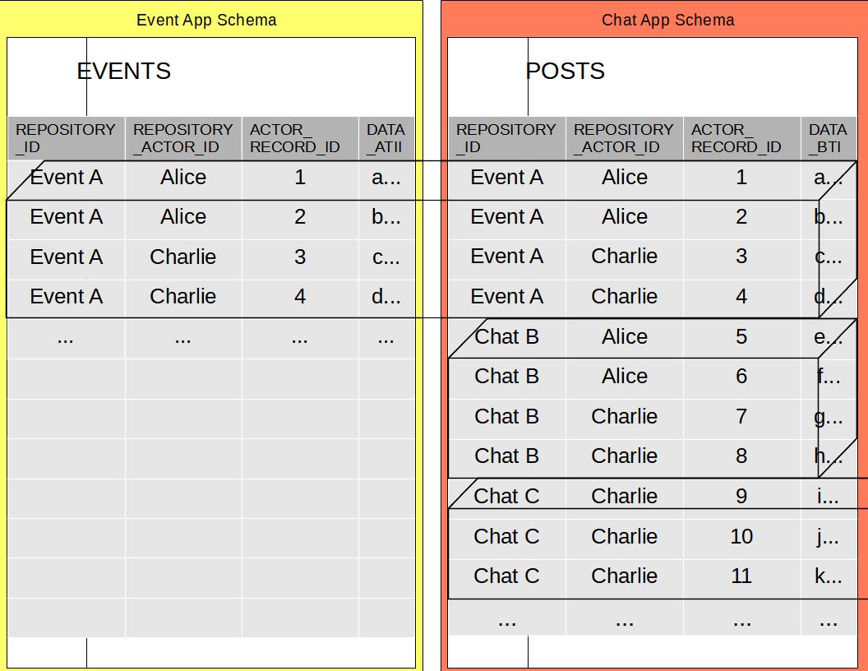

Slide 7
Repository_Id
Repository_Actor_Id
Actor_Record_Id

Slide 8
Per-Repository transaction logs
Transactions split per Repository

Slide 9
Repository usable in isolation
Data copied by Foreign Keys

Slide 10
Original foreign keys retained
Can join by original keys
Missing repositories loaded as needed

Slide 11
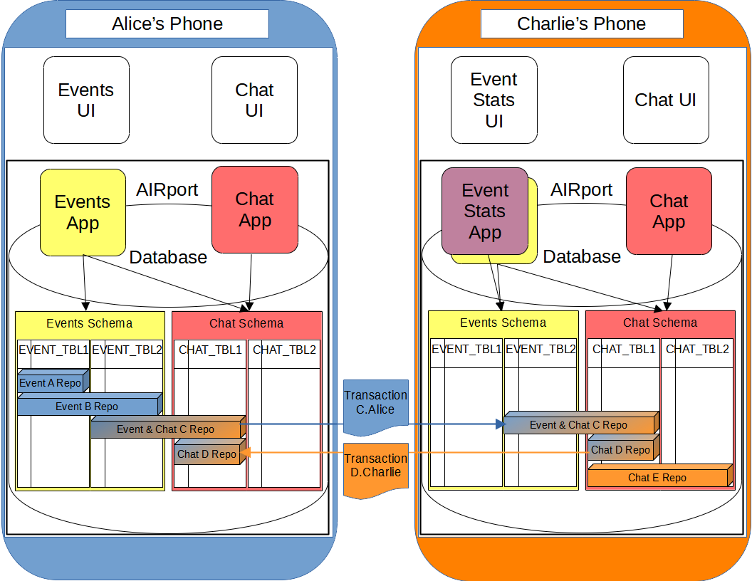

Slide 12
Multiple ORMs supported
Sessionless
Original state tracked “in model”

Slide 13
Entity Mappings

Slide 14
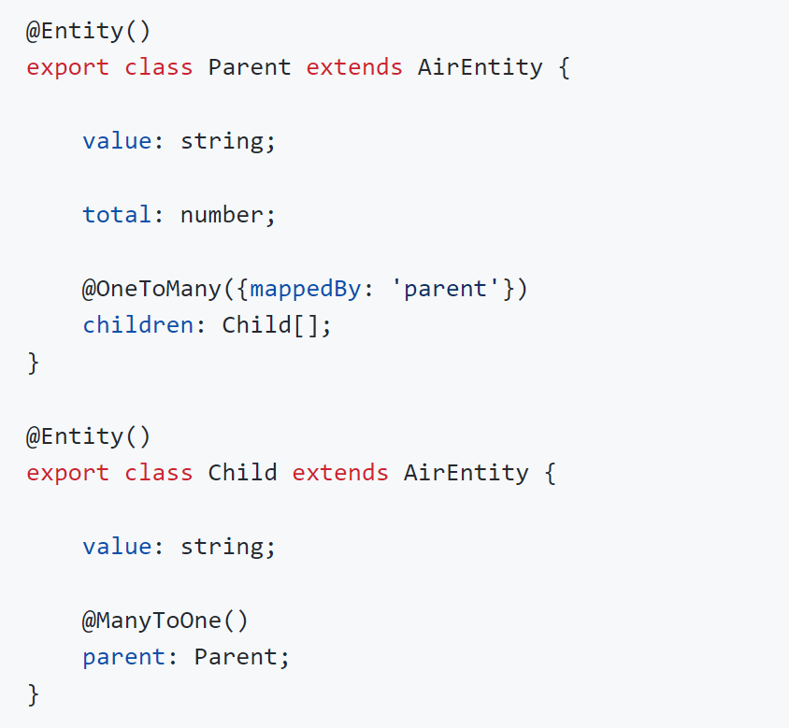

Slide 15
SQL-TypeScript integration

Slide 16
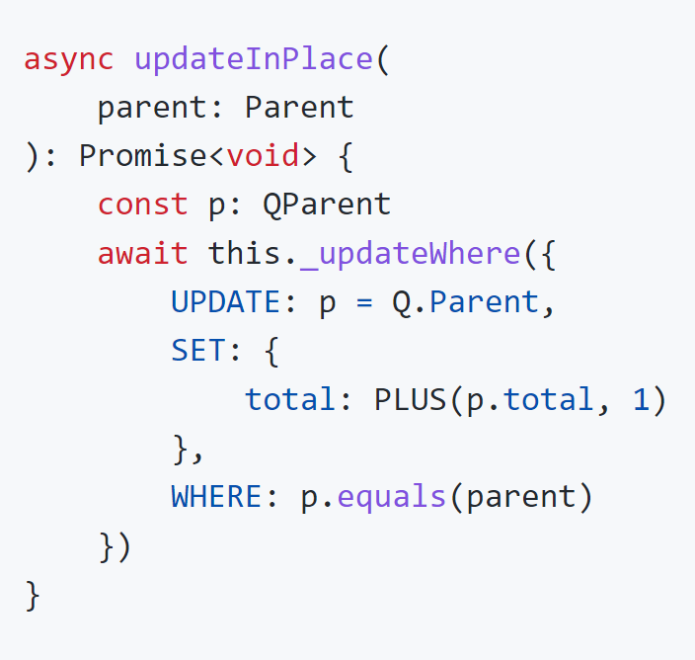

Slide 17
SELECT - object tree

Slide 18
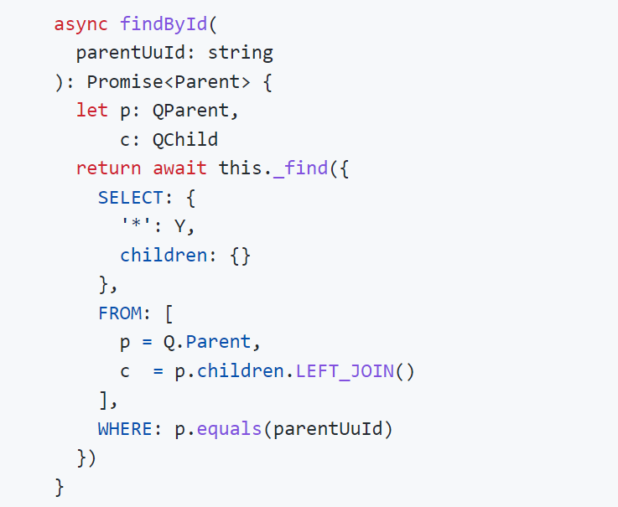

Slide 19
DAO - type safety

Slide 20
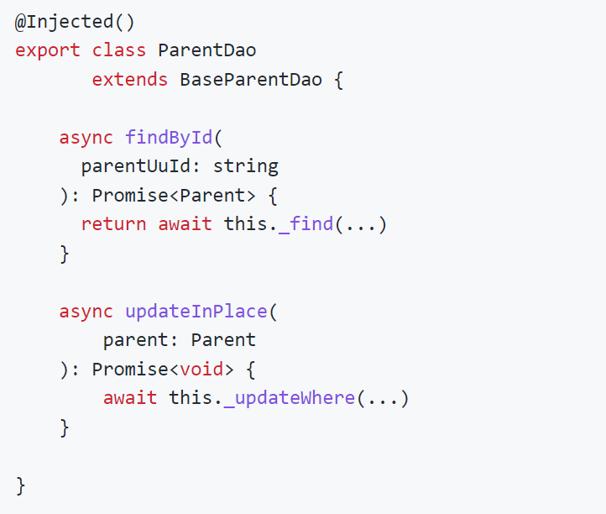

Slide 21
JOIN tables of other Apps
Call APIs of other Apps to modify

Slide 22
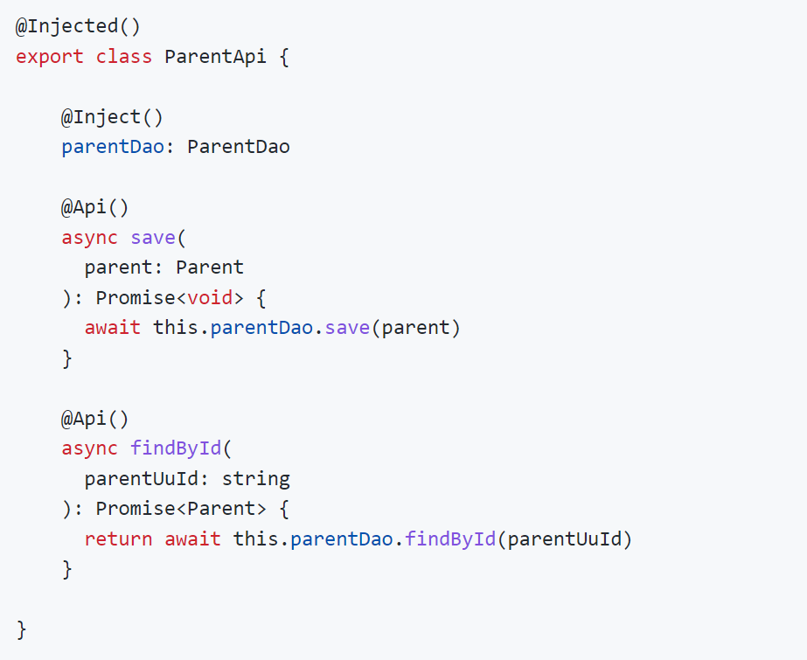

Slide 23
App API call = SQL SAVEPOINT
User & Actor info Request object

Slide 24
Repositories sync across databases
Conflicts resolved automatically

Slide 25
Blockchain per Repository
Single Sign On
Filecoin Adapter Validation

Slide 26
Validation
Entity Based
Declarative
Locked down by default

Slide 27
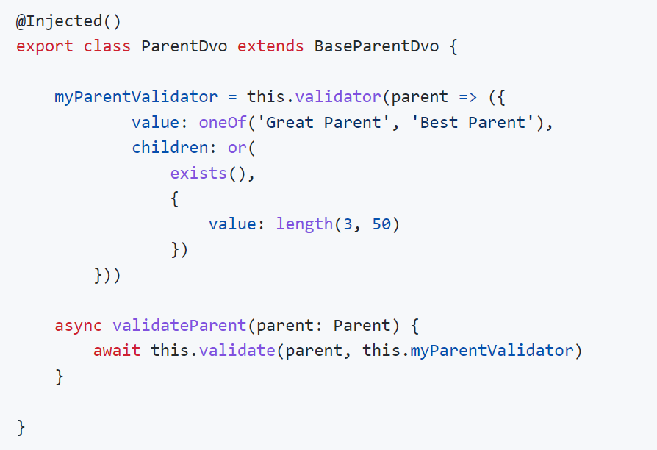

Slide 28
Peer to peer Repository peer discovery Real time updates

Slide 29
Highway – Airport for server

Slide 30
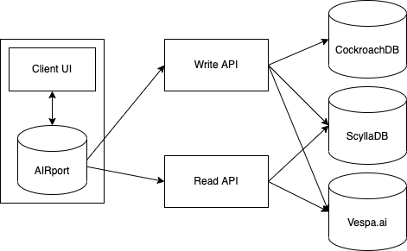

Slide 31
Network of execution nodes
Multiple data sources

Slide 32
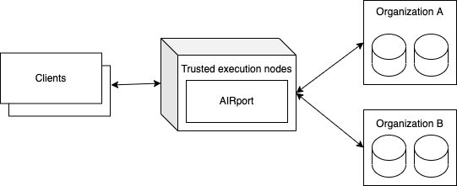

Slide 33

https://beyond-decentralized.world

